Slide 1
What are they like?

Slide 2
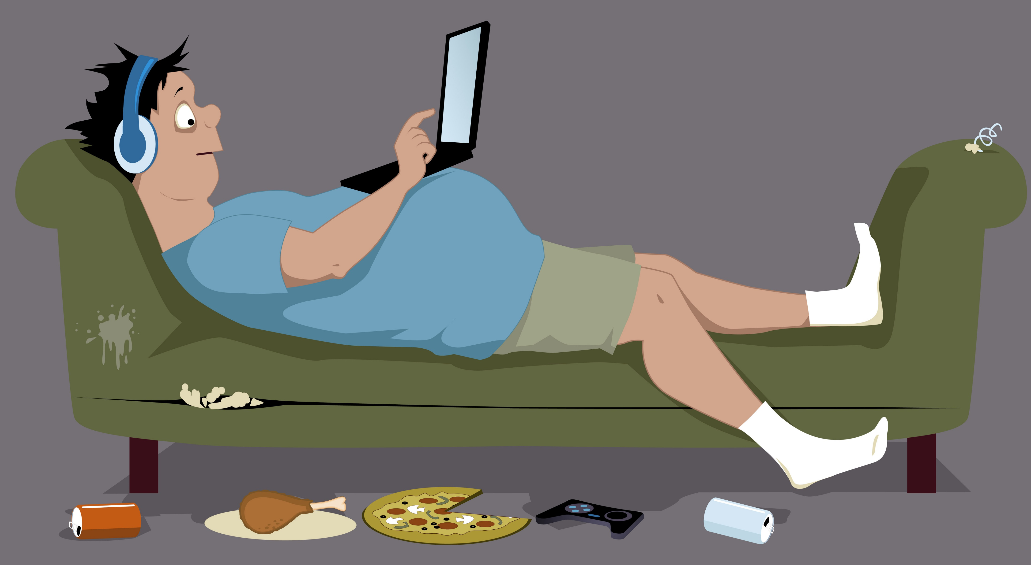

COUCH POTATO

Slide 3
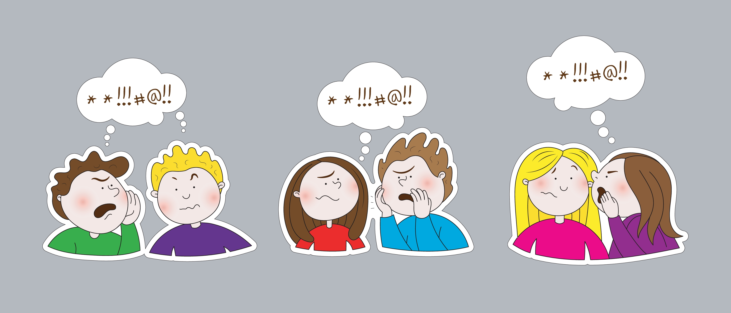
GOSSIPY

Slide 4


CHATTERBOX

Slide 5
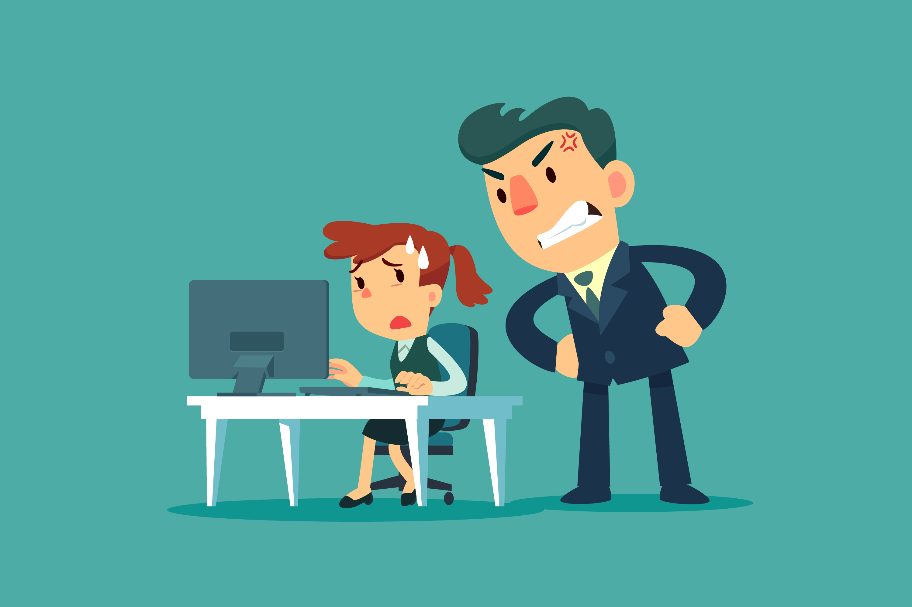
BOSSY

Slide 6
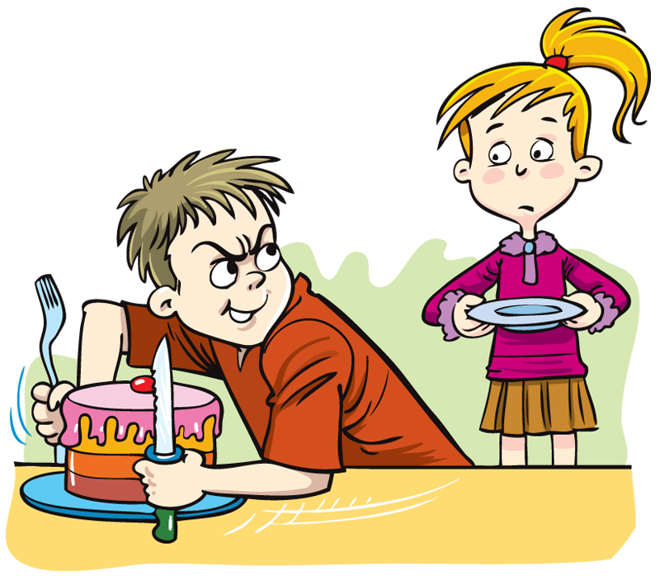
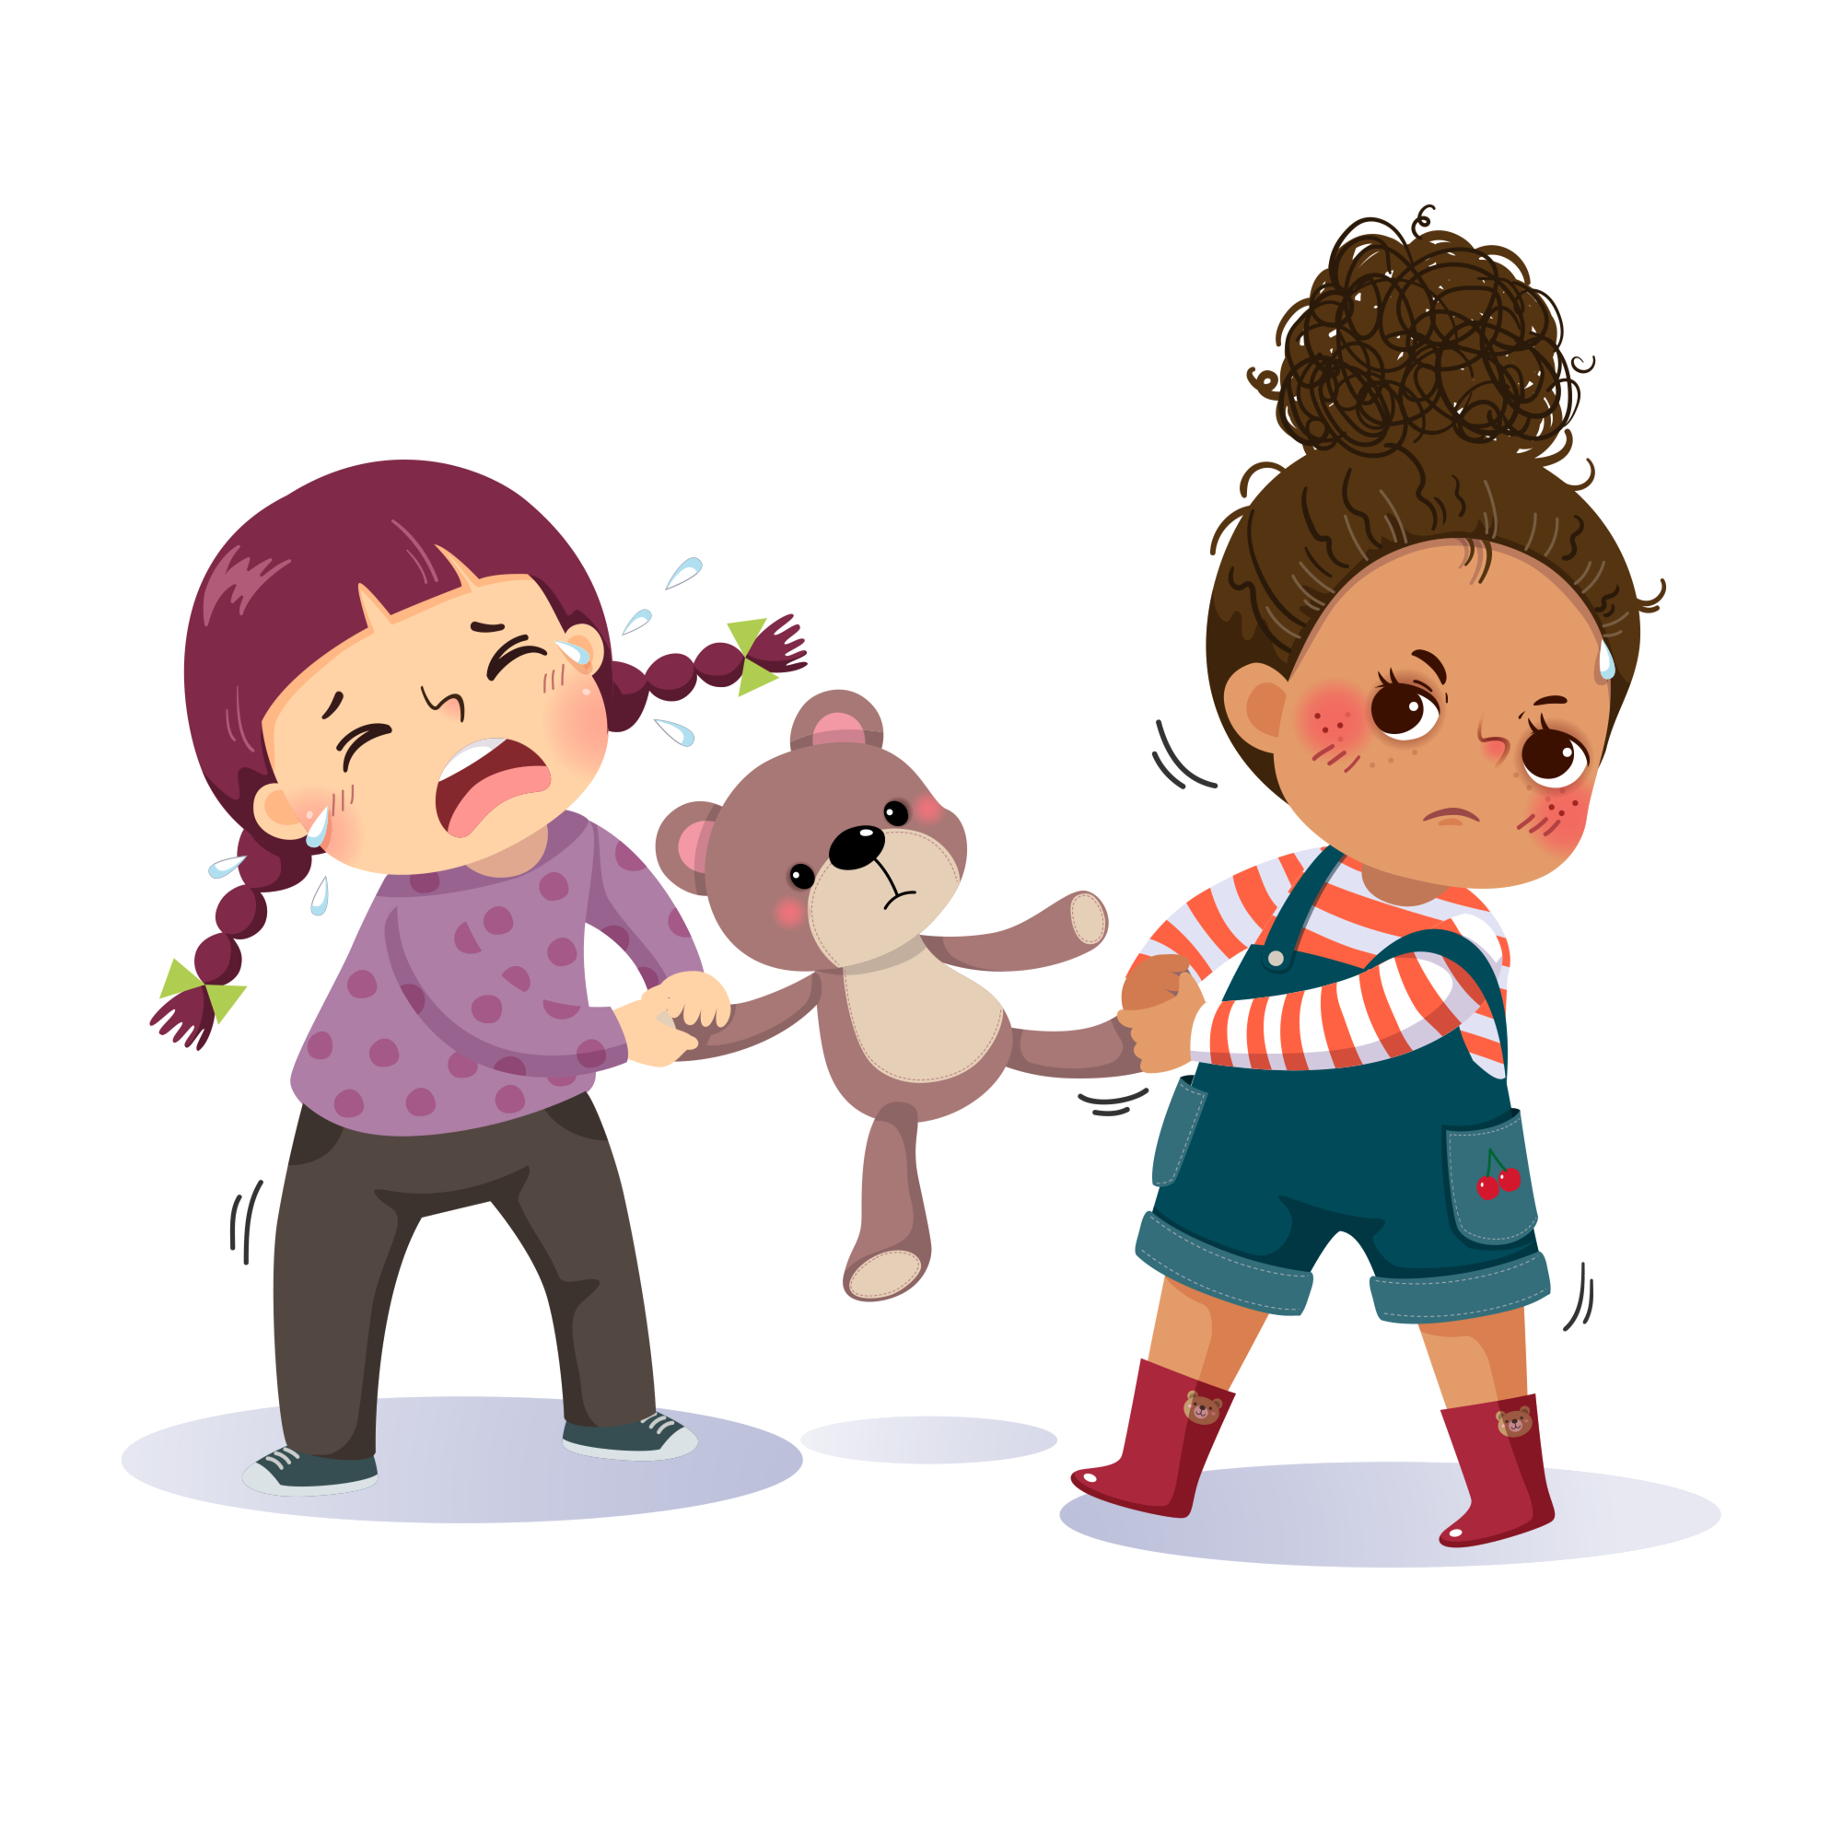
SELFISH

Slide 7
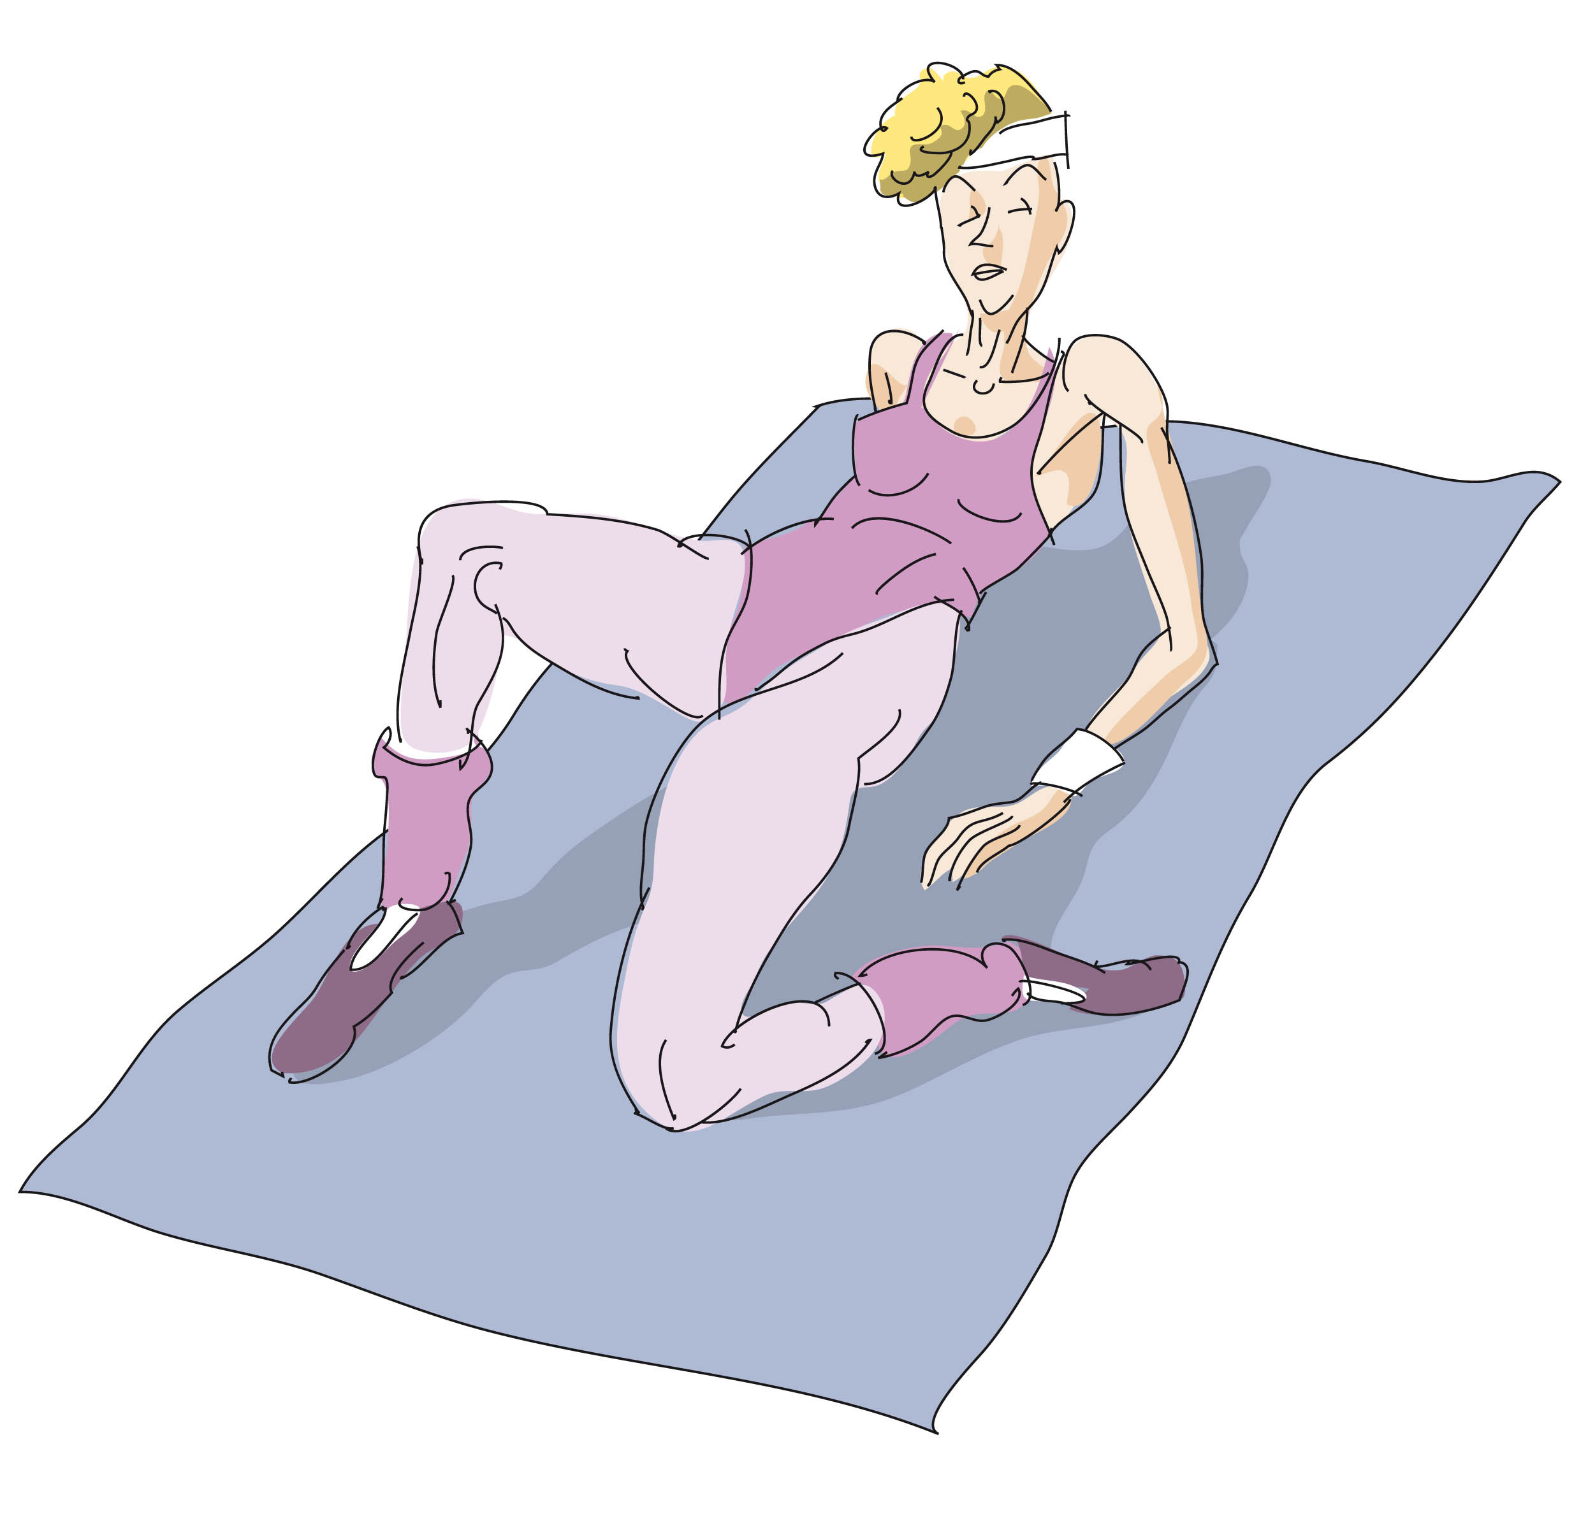
What is she like?
HEALTH FREAK

Slide 8
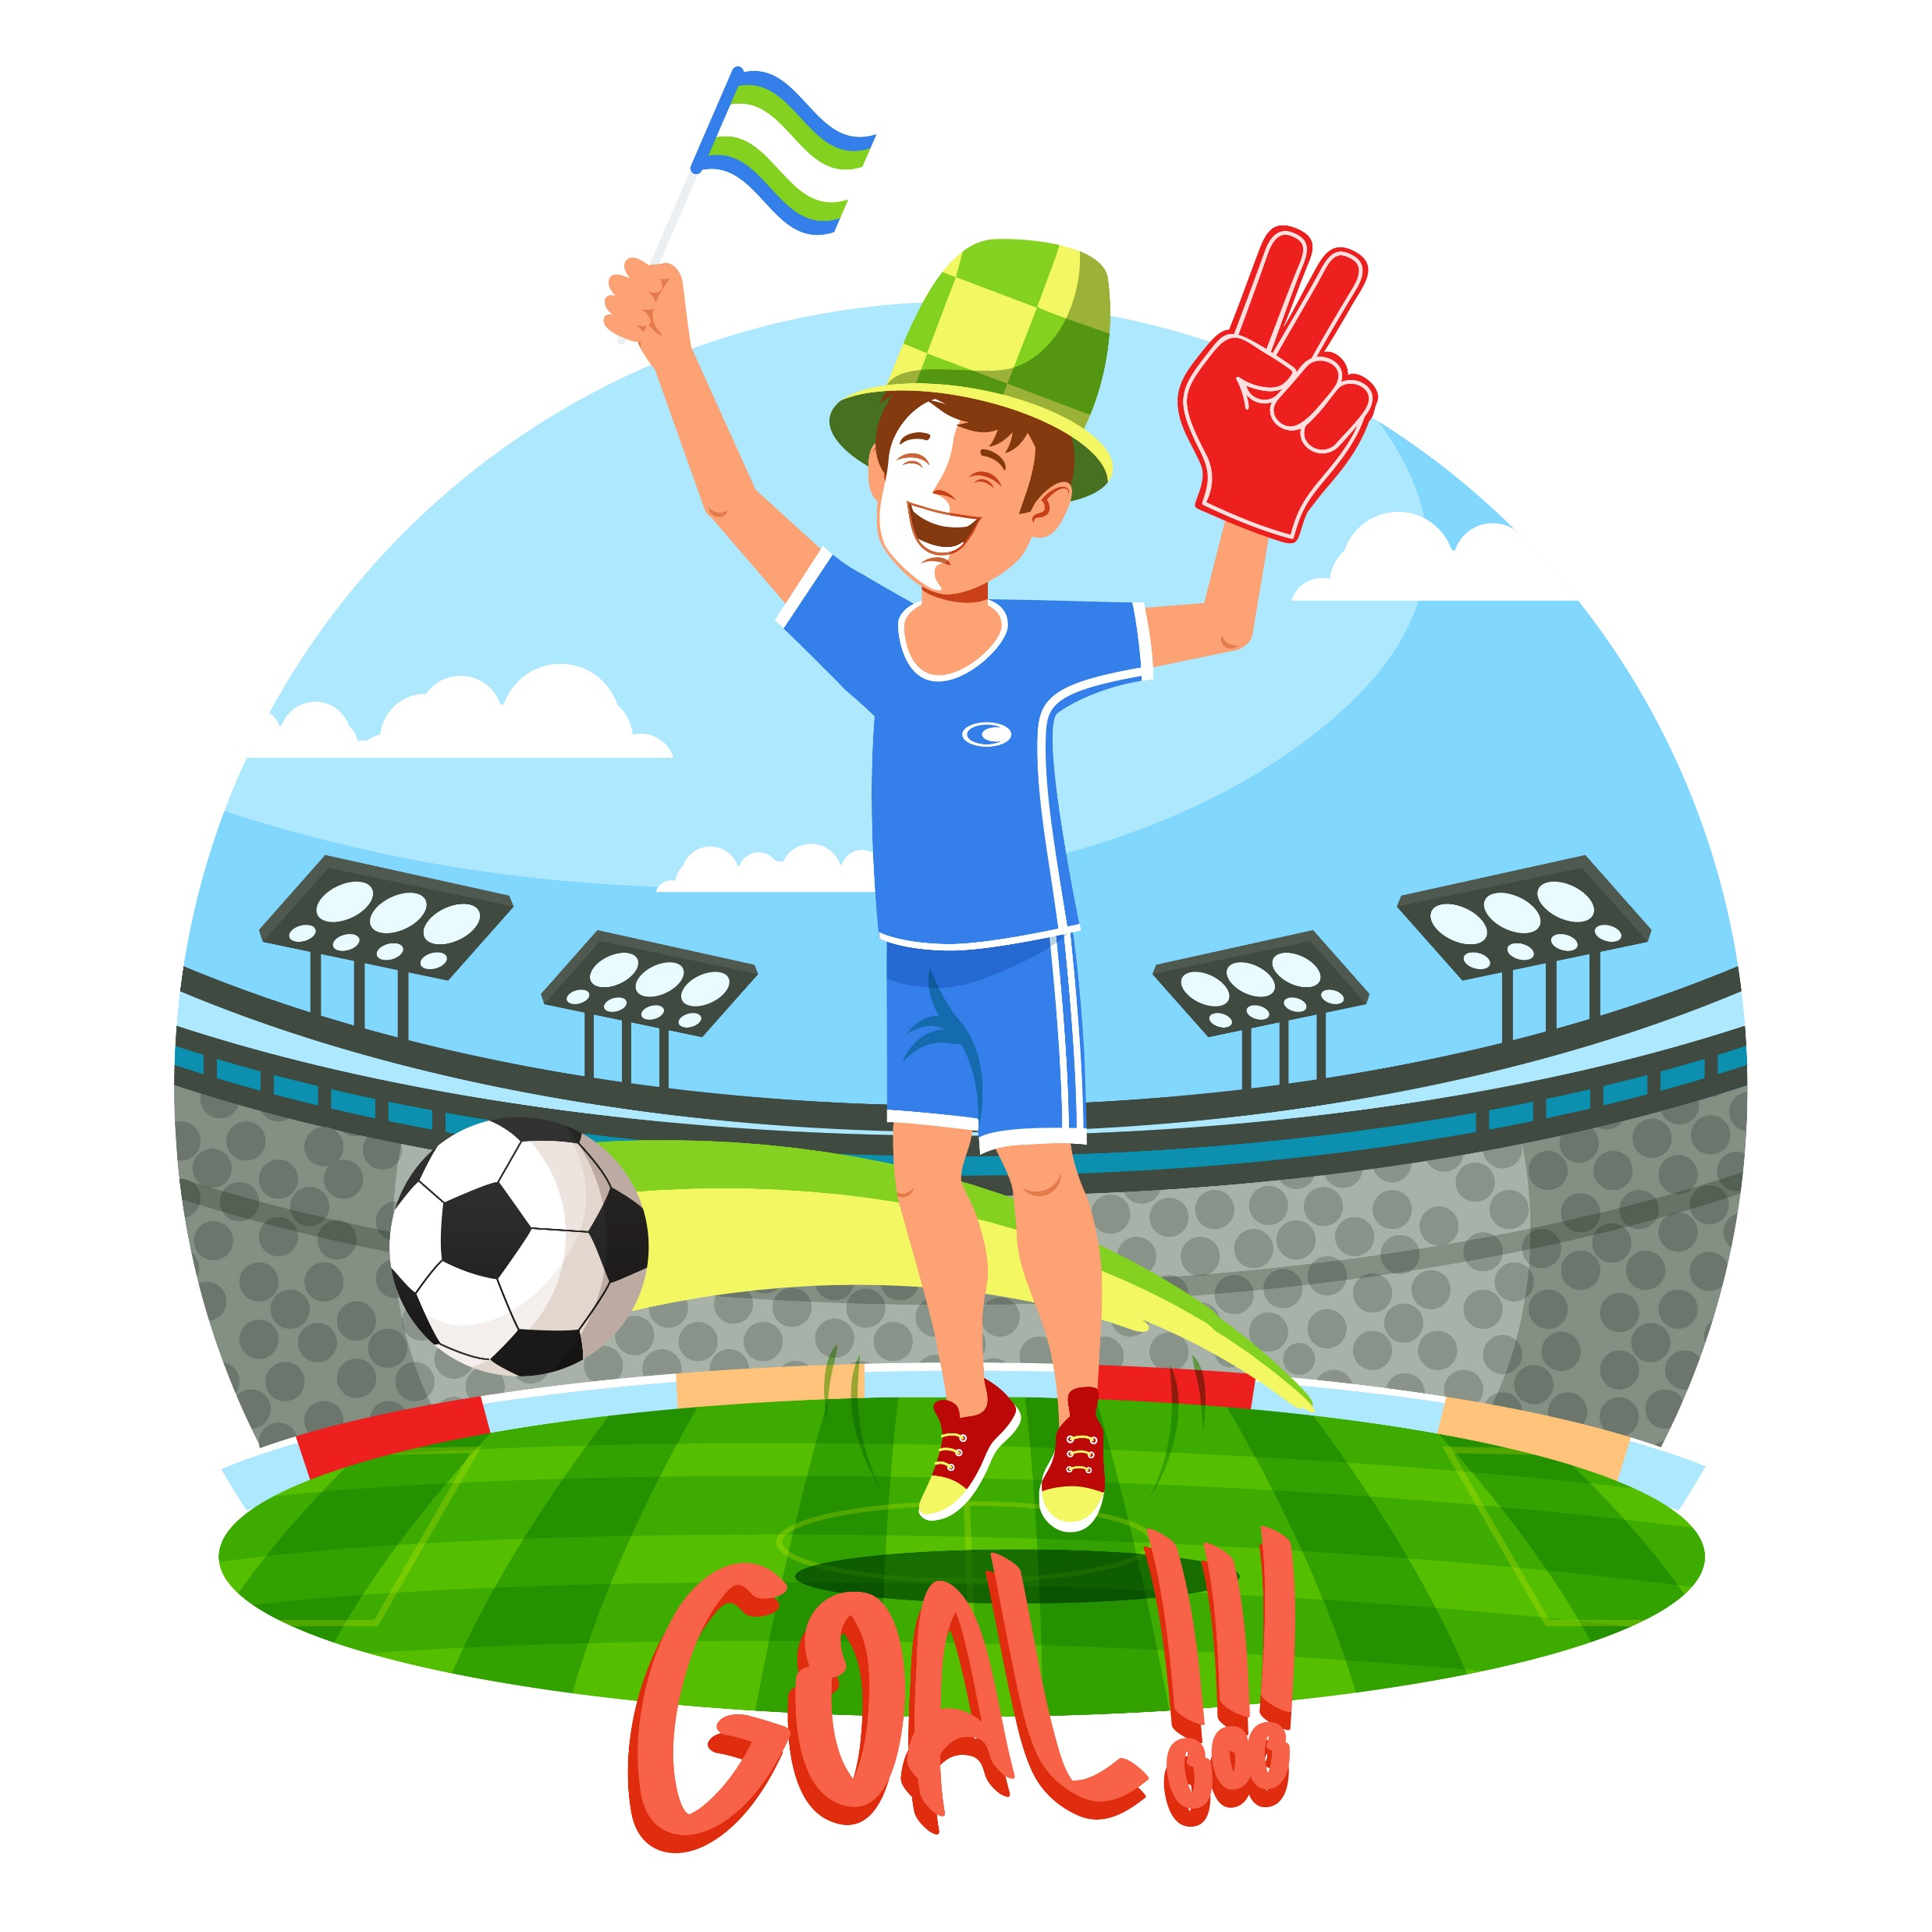

What is he like?
FOOTBALL FAN

Slide 9
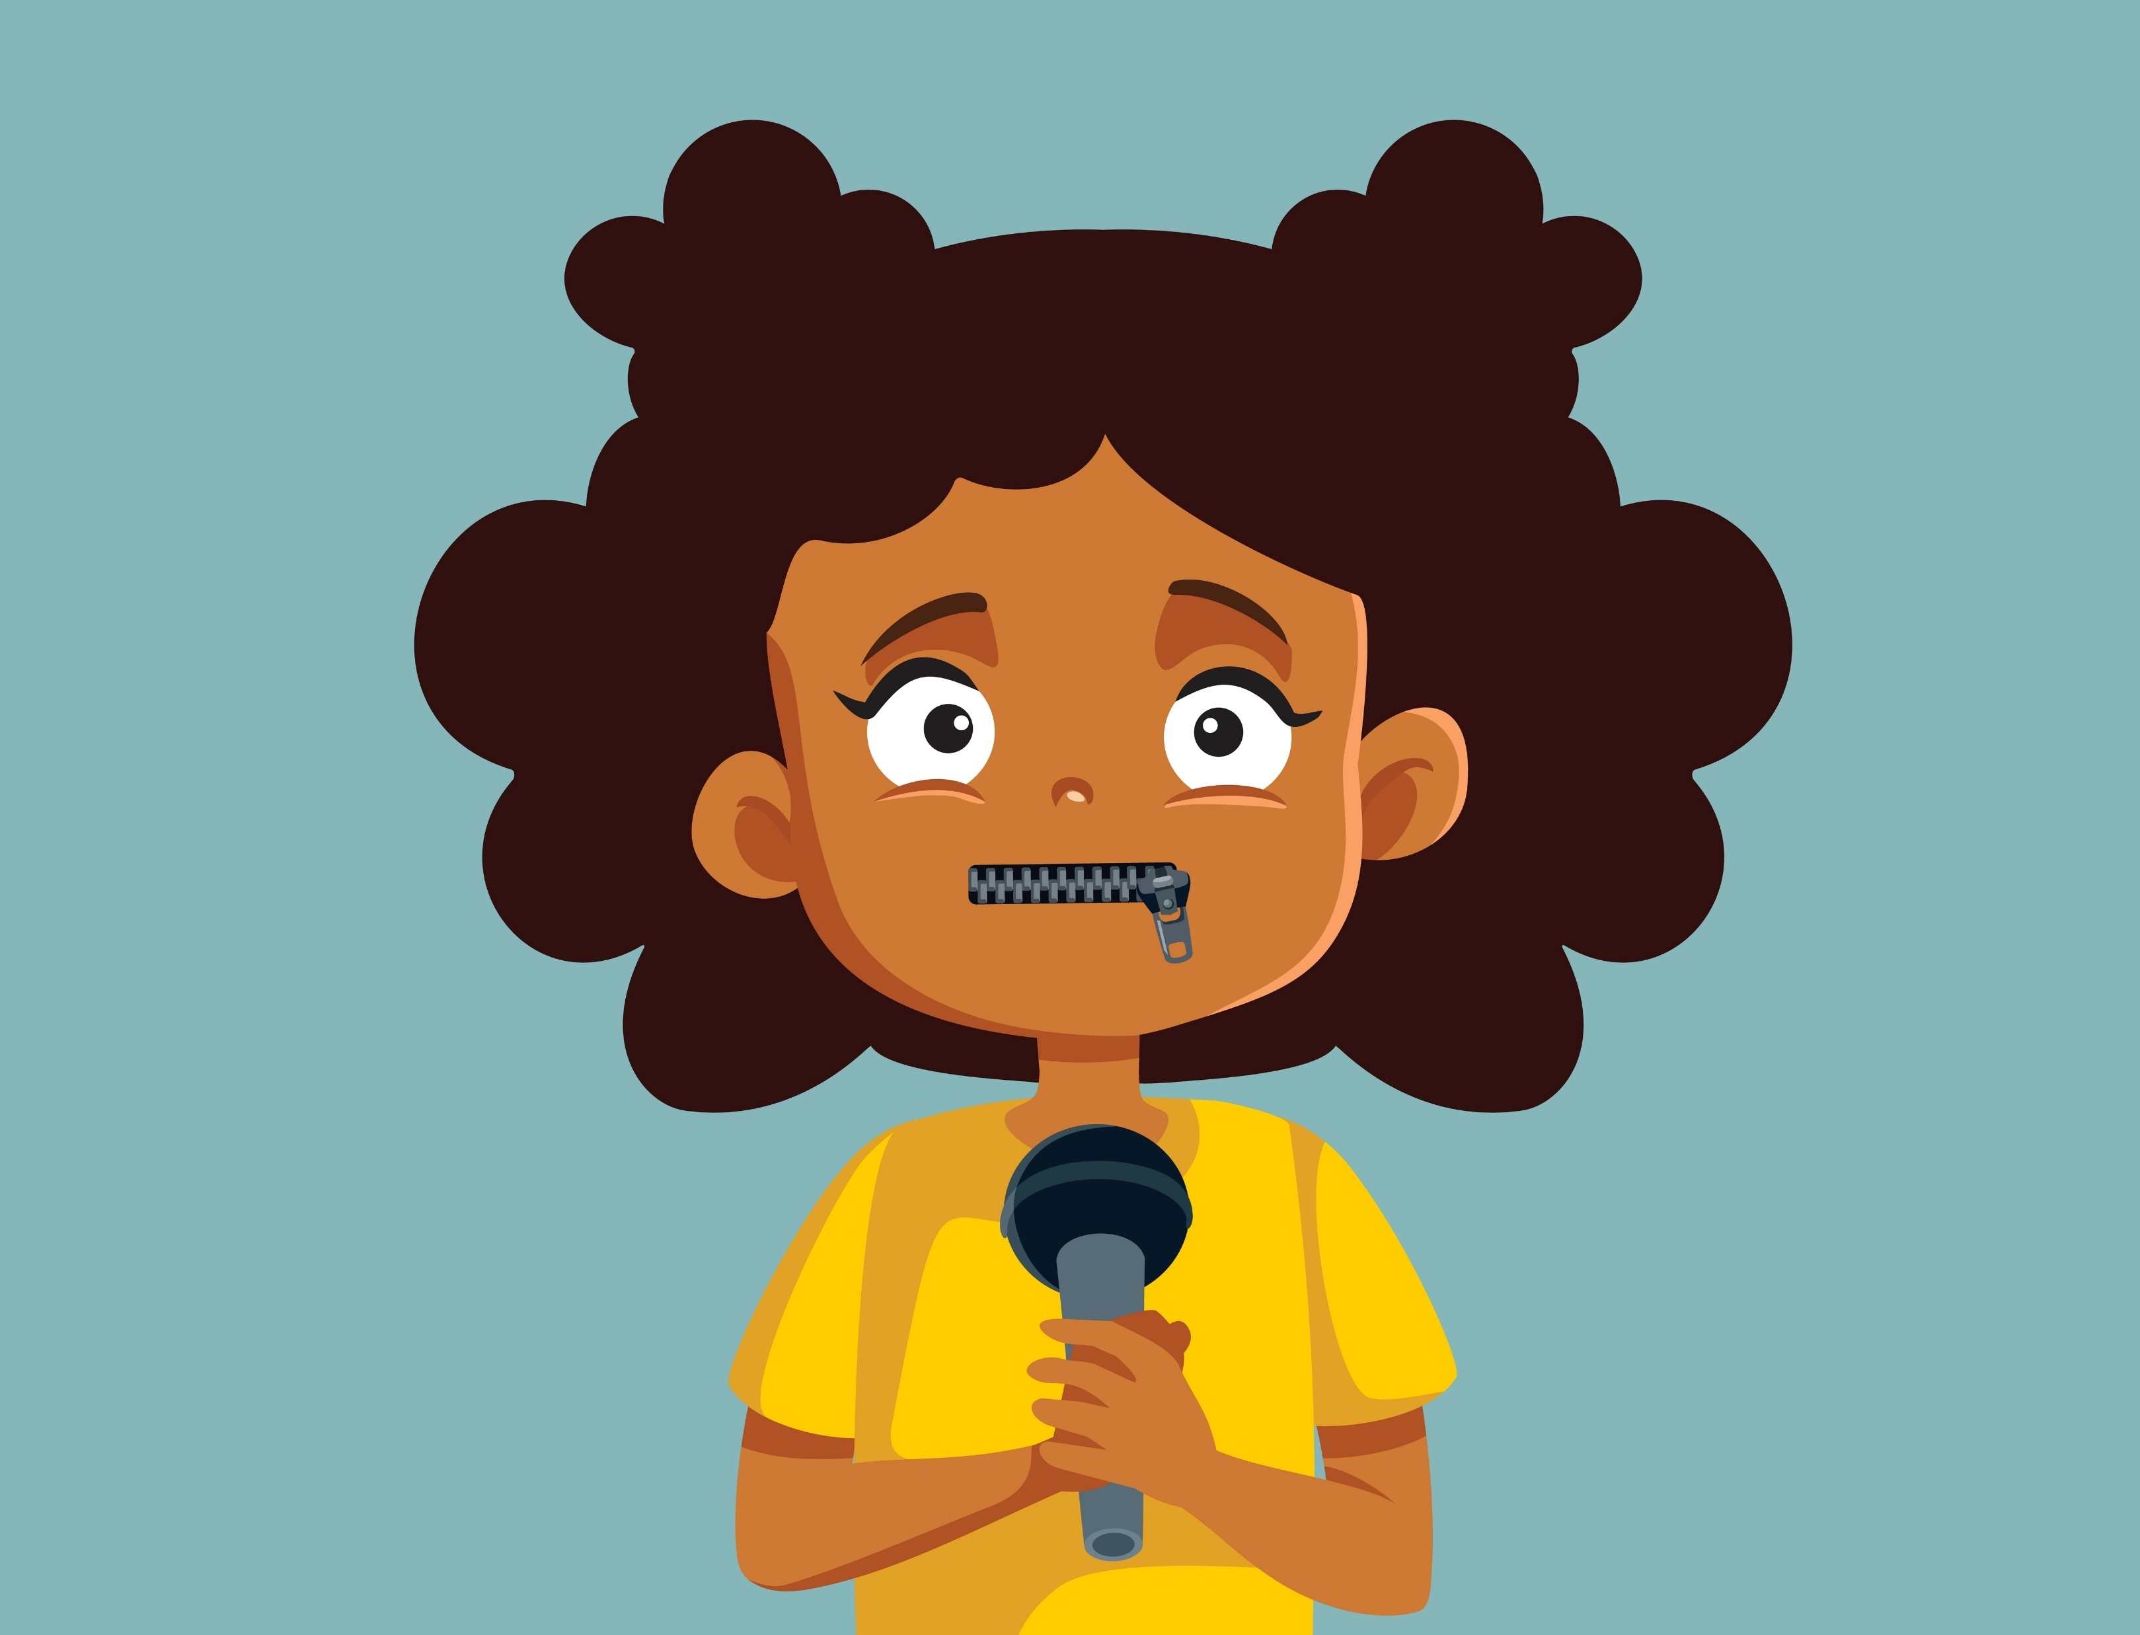
QUIET

Slide 10


VEGETARIAN

